Slide 1

Introduction to Trees
DSLA Course
Rohit Padebettu

Slide 2
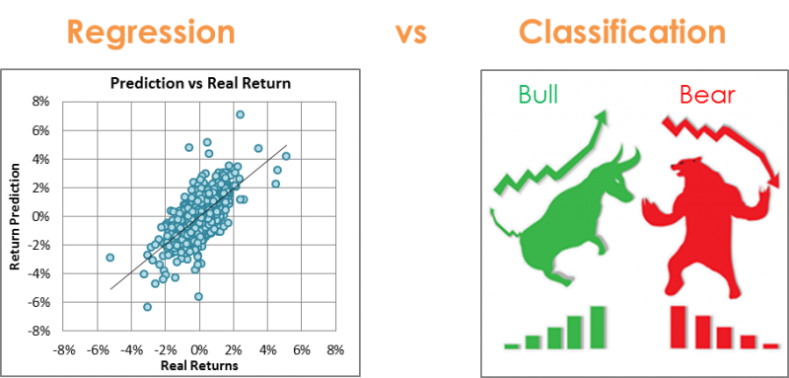
Regression vs Classification

Slide 3

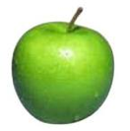


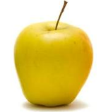
Classification
examples
label₁
label₃
Labeled
Examples
Predicted Label
Data
Model
label₄
label₅
New Unlabeled Data

Slide 4
Classification – Real Life Examples
Hospital Emergency Room measures blood pressure, age, history of illness etc. of newly admitted patients. A decision needs to made regarding admitting the patients into ICU. They want to admit high risk patients. Problem is how to discriminate between high risk and low risk patients?
A Bank receives hundreds and thousands of loan applications with information about salary, age, marital status, other loans, credit history, employment status etc. The bank wants to make loans to those people who are most likely going to repay the loan. Problem is how to discriminate between those who are a good credit risk and those who are bad credit risk?

Slide 5
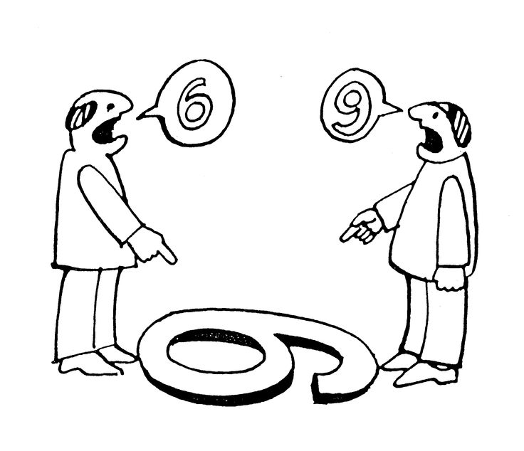
Classification – Other Examples
Face/Speech Recognition
Character Recognition
Spam Detection
Customer Segmentation
Recommendation Systems

Slide 6

Classification – How?
Logistic, LDA, QDA, KNN for Classification – We got this!
In this session we will learn about tree based algorithms which can be used for regression as well as classification
Decision Trees
Pruning and Bagging Trees
Random Forests
Gradient Boosting Method

Slide 7
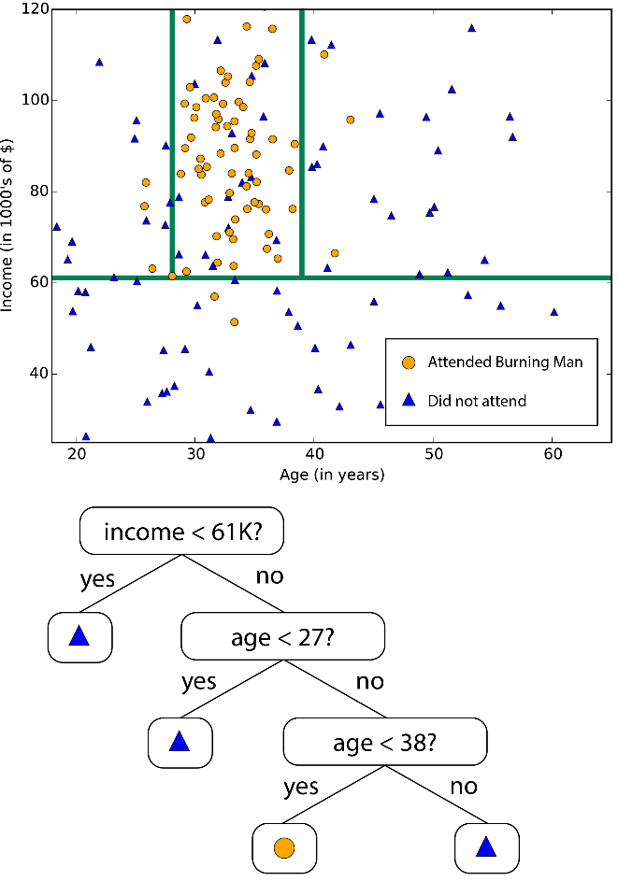
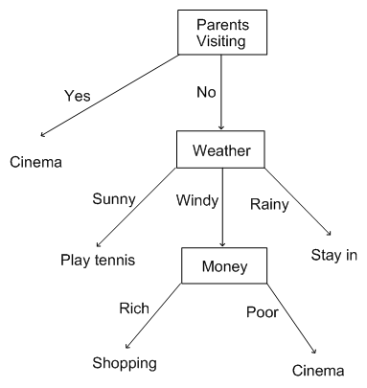
Decision Trees – Examples
How do you decide what to do on a Holiday ?
How do you know who attended Burning Man?

Slide 8
Decision Trees – Examples
Would you survive if you were on the Titanic ?
Actual Kaggle Dataset

Slide 9
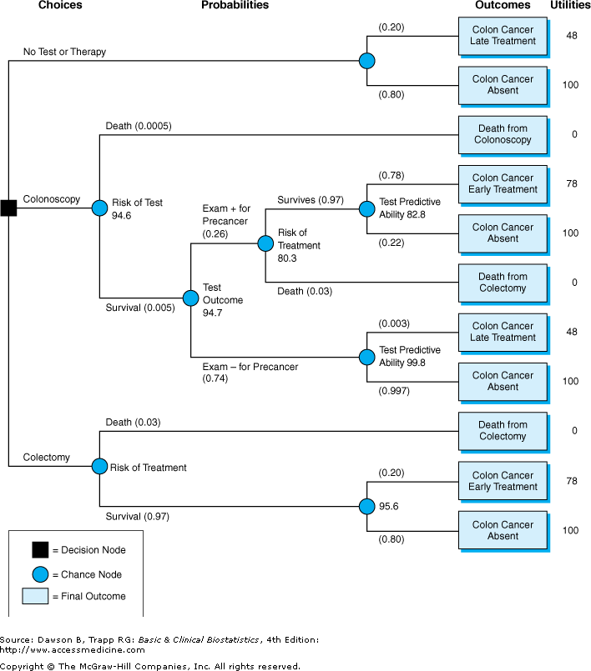
Decision Trees – Examples
Even for serious Medical Diagnosis

Slide 10
Decision Trees – When?
When to use Decision Trees over the other Algorithms we have learnt ?
If the relationship between dependent & independent variable is well approximated by a linear model, linear regression will outperform tree based model.
If there is a high non-linearity & complex relationship between dependent & independent variables, a tree model will outperform a classical regression method.
If you need to build a model which is easy to explain to people, a decision tree model will always do better than a linear model. Decision tree models are even simpler to interpret than linear regression!

Slide 11
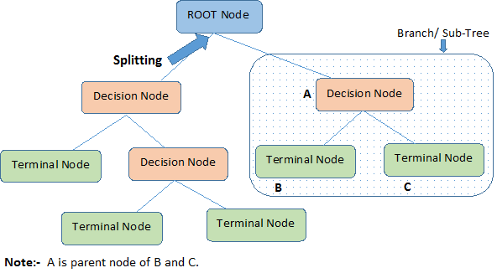
Decision Trees – How?
Start at the Root Node with all the data
Split data based on a predictor using a decision criteria.
This produces two sub-nodes which are split further using a different attribute and only data assigned to that node.
Tree is grown until terminal or leaf nodes are produced which satisfy the criteria

Slide 12
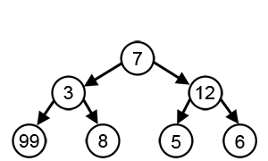
Decision Trees – Greedy Search
A search method that makes the best locally optimum choices at each stage with the hope of finding a global optimum
Common criteria used in growing Trees
Minimum Classification Error
Maximum Information Gain
Least Entropy or Maximum Purity
Maximum Reduction in Variance
Depth of Tree
Minimum Observations at a node
Criteria here is to find the largest sum, but Greedy Algorithm makes the locally optimum choice.

Slide 13
Decision Trees – Advantages
Easy to Understand
Less Data Cleaning required compared to other models
Handles Quantitative as well as Categorical Variables
Non Parametric – No Mathematical assumptions about the data
Easily handle complex non-linear relationships in data
Easy to Visualize and Interpret
Rules based

Slide 14
Decision Trees – Disadvantages
Large deep trees may suffer from over-fitting data
Once a mistake is made at higher level, sub trees can be wrong
Process of growing a tree is computationally expensive
Some information loss when handling continuous variables
Relies on rectangular approximation which might not be good for some datasets
Less Data and more classes can lead to over-fitting

Slide 15
Bias Variance Problem
Under fitting leads to overly simplified models which haven’t learned all the patterns in the data.
Stubs or one node trees are prone to this
Overfitting leads to increased model complexity which leads to a variance problem as the model learns the noise in the data.
Large trees are prone to this

Slide 16
Bias Variance Problem
To Reduce Variance
Get more data
Reduce Features
Regularization
Pruning
Ensemble Models
To Reduce Bias
Obtain more features
More data – but it doesn’t help beyond a point
The key is pay attention to difference between training set error and test/validation set error

Slide 17
Cross Validation
Cross Validation is used for
Estimating Model error
Generalizing a model
Model Selection
Model Parameter Selection
A solution for over-fitting
Avoid the model learning the noise in the data by repeatedly testing it using “pretend test samples”

Slide 18
Pruning Trees
Pruning is replacing entire sub-trees with a leaf node if doing so improves validation error. This prevents over-fitting and helps generalize the model to unseen data.
Two approaches to Pruning
Pre-Pruning
Halt tree construction early and do not split a node if fit criteria is not met.
Minimum observations in node
Depth of Tree
Threshold for information gain
Threshold for classification error
Pre-Pruning is faster
Post-Pruning
Grow the tree fully to allow overfitting and then prune
Get a sequence of pruned trees by removing sub-trees/branches
Use the validation set to decide which is “best pruned tree”
Post-Pruning is more accurate

Slide 19
Bagging Trees – Ensemble Learning
Another very popular cure for over-fitting/ high variance problem
Randomly select samples from training data
Fully grow trees for each sample
Each such tree makes prediction on the test data
Average the predictions (regression) or use the most popular vote (classification)

Slide 20
Random Forest
Random Forest is a more generalized version of the Bagging Algorithm
Randomly select samples from training data
Also randomly select number of predictors in each such sample
Fully grow trees for each sample
Each such tree makes prediction on the test data
Average the predictions (regression) or use the most popular vote (classification)
A diversified variety of trees are grown, which leads to less variance and more accuracy

Slide 21
Random Forests
Advantages | Disadvantages
Does Regression and Classification
Power to handle large data set with high dimensionality
Handles missing data
Handles imbalanced classes data
Outputs importance of variables
May over-fit particularly noisy data
In regression cannot predict beyond the limits of the data
Is a bit of black box in what the model does

Slide 22
Boosting Algorithms
Boosting refers to this general problem of producing a very accurate prediction rule by combining rough and moderately inaccurate rules-of-thumb.
Sequentially combines a bunch of weak learners to produce a strong learner.
Instead of fully grown trees, decision stumps are produced
Incorrectly classified observations by weak learners are given higher weight
New weak learners are added focusing their ability on these misclassified observations
Adaboost

Slide 23
Gradient Boosting Machine
Very popular Machine Learning model. The XGBoost variant of this model wins quite a lot of Kaggle competitions
Is a more generalized version of AdaBoost
New weak learner focuses on the residual errors of the existing trees in the ensemble and tries to model them

Slide 24

Machine Learning leads to …

Slide 25
Leaf Classification Case
Team Introductions

Slide 26
Leaf Classification Case
Lunch

Slide 27
Leaf Classification Case
Demo Time

Slide 28
Course Assignments
Programming Assignments
Reading Assignments
Presentation Assignments
Technical Skills Assignments
Writing Assignments

Slide 29
Technical Assignment
Complete & Submit Code on GitHub for Mushroom Classification

Slide 30
Programming Assignment
Install & Complete: Swirl – Regression Models
Install & Complete: Swirl – Getting & Cleaning Data

Slide 31
Reading Assignment
Read Chapter 4: Classification
Read Chapter 8: Tree Based Methods

Slide 32
Writing Assignment
No Writing Assignment this week !!!

Slide 33
Presentation Assignment
By Saturday Submit
Your Presentations on Mushroom Classification Case
Technical Presentation
Business Presentation (Not to exceed 5 slides)

